Slide 1
Preventive Safety and Communication System Accessory for Motorcyclists
The best communication tool for your biking group

Slide 2
Presentation Overview
Problem Statement
Need Finding
Empathy Map
Low Fidelity Prototype
Heuristic Evaluation
High Fidelity Prototype

Slide 3
Problem Statement
Preventive Safety and communication System Accessory for Motorcyclist Communities during extended travels.

Slide 4
Need Finding
01
Emergencies
02
Communication and Navigation
03
Luxuries

Slide 5
Emergencies
Accident
Back Up Call
Automatic Alert

Slide 6
Communication
Fuel
Repair / Maintenance
Refreshment
Intermediate Travel Destination

Slide 7
Navigation
Weather
Road Condition
Highway Traffic / Accidents

Slide 8
Luxuries
Music System Control
Call Reception

Slide 9
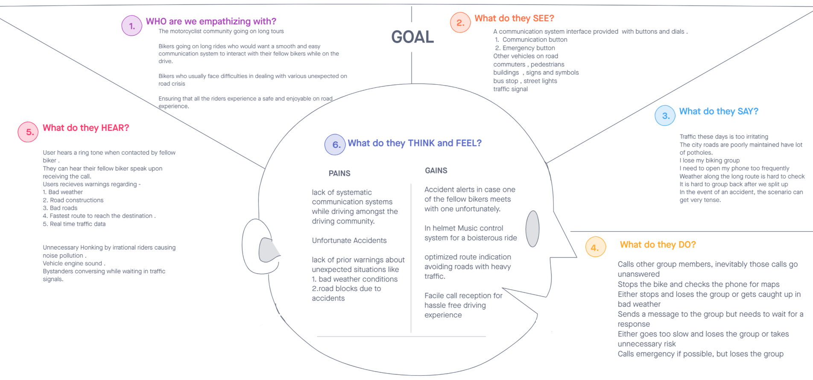
Empathy Map

Slide 10
Low Fidelity Prototype

Slide 11
Heuristic Evaluation
Schneider's 8 principles of Interaction Heuristics

Slide 12
Heuristic Evaluation 1
Consistency
Shortcuts for Frequent Users
Informative Feedback
Design Dialogues to Yield Closure

Slide 13
Heuristic Evaluation 2
Error Prevention and Handling
Easy Reversal of Actions
Support Internal Locus of Control
Reduction of Short Term Memory Load

Slide 14


High Fidelity Prototype
Demonstration of the concept of our Biker Communication System
Interface
In helmet - Audio System
Handlebar Buttons
Emergency
Communication

Slide 15
High Fidelity Prototype

Slide 16
Thank you!
Anirudh S Ayya (PES1201800338)
Vishnu R Dixit (PES1201801448)
S NIKHIL RAM (PES1201801972)
Vikas Gowda (PES1201801857)
Pranav BG (PES1201801657)

